Slide 1
Smart Pharmacy: Revolutionizing Healthcare with Technology

Slide 2

The healthcare industry is constantly evolving, embracing technological advancements to enhance patient care and streamline operations.
Smart pharmacies represent a cutting-edge approach to medication management, utilizing technology to improve efficiency, accuracy, and patient safety.
Benefits of Smart Pharmacies
Improved Efficiency
Enhanced Accuracy
Patient Safety
Personalized Care

Slide 3
Key Features of Smart Pharmacies
• Automated Medication Dispensing
• Real-Time Inventory Management
• Patient Medication Tracking
• Prescription Management
• Patient Education and Adherence

Slide 4

Related Work: Academic Papers
• A case study of the implementation of a robotic dispensing system in a hospital pharmacy (International Journal of Pharmacy Practice, 2020)
• The impact of a robotic dispensing system on medication dispensing errors (Pharmacotherapy, 2019)
• Patient satisfaction with a robotic dispensing system in a hospital pharmacy (Journal of Pharmacy Practice, 2020)

Slide 5

Related Work: News Articles
• First smart pharmacy run by robot begins at Rashid Hospital (Gulf News, 2018)
• The robot will see you now: Dubai hospital launches new smart pharmacy (The National, 2018)
• DHA launches 5th smart pharmacy for dispensing and prescribing medication (Media Center, 2019)

Slide 6
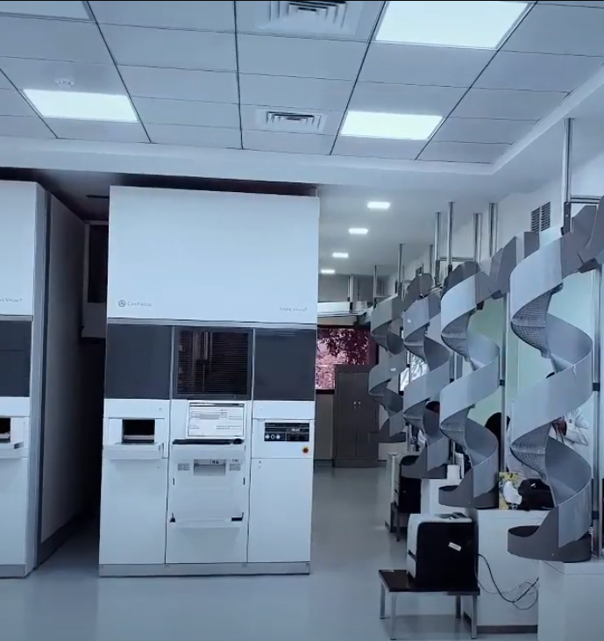
Related Work: News Articles
The conveyor belt system moves medications around the room, allowing pickers to efficiently select the correct medications from the shelves. The picking stations are equipped with scanners that verify the accuracy of each pick. The medications are then packaged and shipped out to pharmacies and other healthcare providers.
The automated picking and packing system in this image helps to ensure the accuracy and efficiency of the medication dispensing process. It also helps to reduce the risk of errors and contamination.

Slide 7
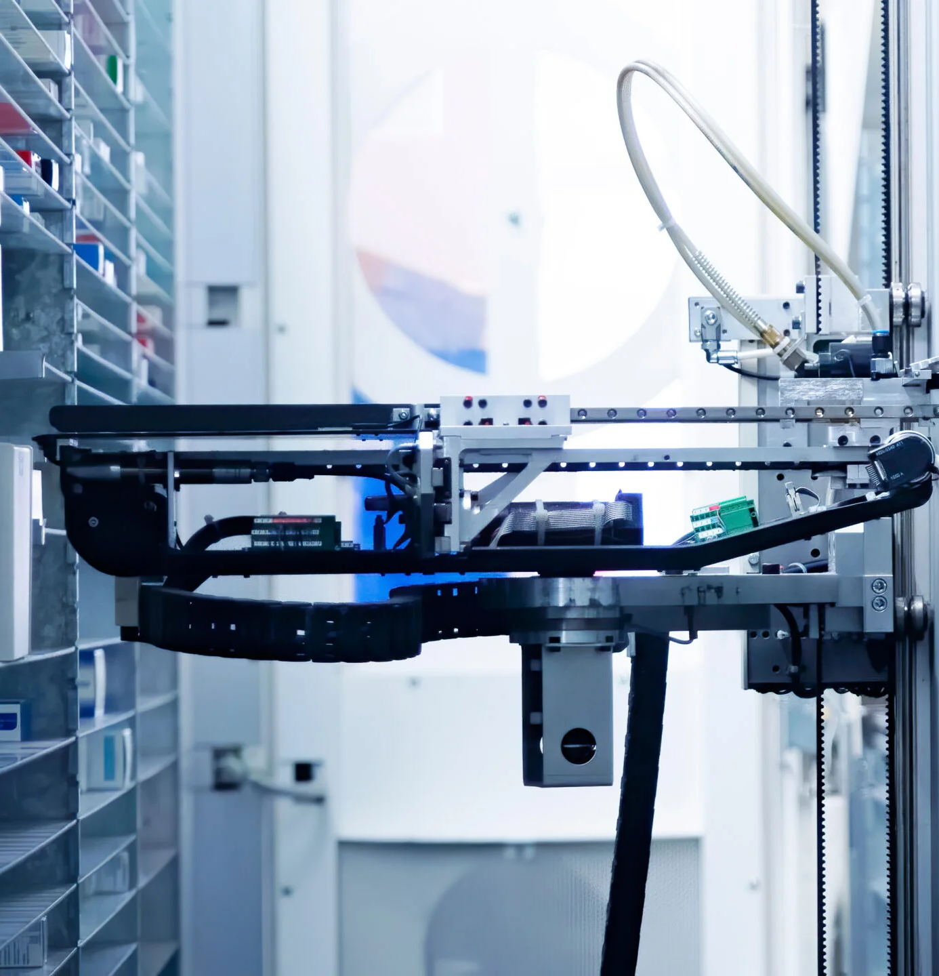
Related Work: News Articles
Robotic medication dispensing systems are automated systems that use robots to dispense medications from shelves and place them on conveyor belts for packaging and shipping. These systems offer several advantages over manual dispensing,
including:
Increased accuracy: Robots can dispense medications with a very high degree of accuracy, which helps to reduce the risk of errors.
Increased efficiency: Robots can dispense medications much faster than humans, which can help to improve the workflow in a pharmacy or other healthcare setting.

Slide 8
Related Work: News Articles
Robotic medication dispensing systems are automated systems that use robots to dispense medications from shelves and place them on conveyor belts for packaging and shipping. These systems offer several advantages over manual dispensing,
including:
Reduced costs: Robotic medication dispensing systems can help to reduce labor costs and other associated expenses.
Improved safety: Robotic medication dispensing systems can help to reduce the risk of workplace injuries, such as repetitive strain injuries.

Slide 9
Related Work: Websites
• Dubai Health Authority
• Rashid Hospital

Slide 10

References
News articles:
"First smart pharmacy run by robot begins at Rashid Hospital" (Gulf News, 2018) https://m.edarabia.com/first-smart-pharmacy-run-by-robot-begins-at-rashid-hospita/91786/
"The robot will see you now: Dubai hospital launches new smart pharmacy" (The National, 2018) https://www.thenationalnews.com/uae/the-robot-will-see-you-now-dubai-hospital-launches-new-smart-pharmacy-1.785651
"DHA launches 5th smart pharmacy for dispensing and prescribing medication" (Media Center, 2019) https://www.zawya.com/en/press-release/dubais-dha-launches-smart-pharmacy-with-the-first-robot-in-the-middle-east-for-dispensing-and-prescribing-hp149mhr

Slide 11
References
Academic papers:
"A case study of the implementation of a robotic dispensing system in a hospital pharmacy" (International Journal of Pharmacy Practice, 2020) https://pubmed.ncbi.nlm.nih.gov/35770196/
"The impact of a robotic dispensing system on medication dispensing errors" (Pharmacotherapy, 2019) https://pubmed.ncbi.nlm.nih.gov/8528848/
"Patient satisfaction with a robotic dispensing system in a hospital pharmacy" (Journal of Pharmacy Practice, 2020) https://onlinelibrary.wiley.com/doi/full/10.1111/jep.13014

